Slide 1

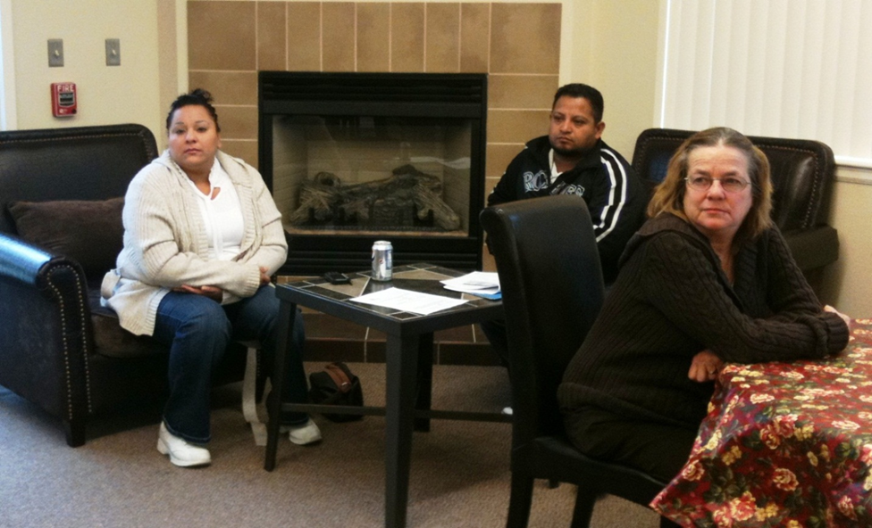
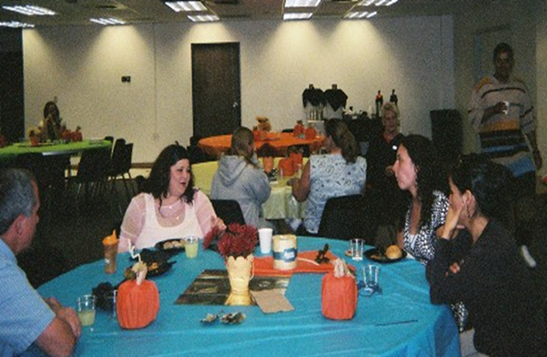
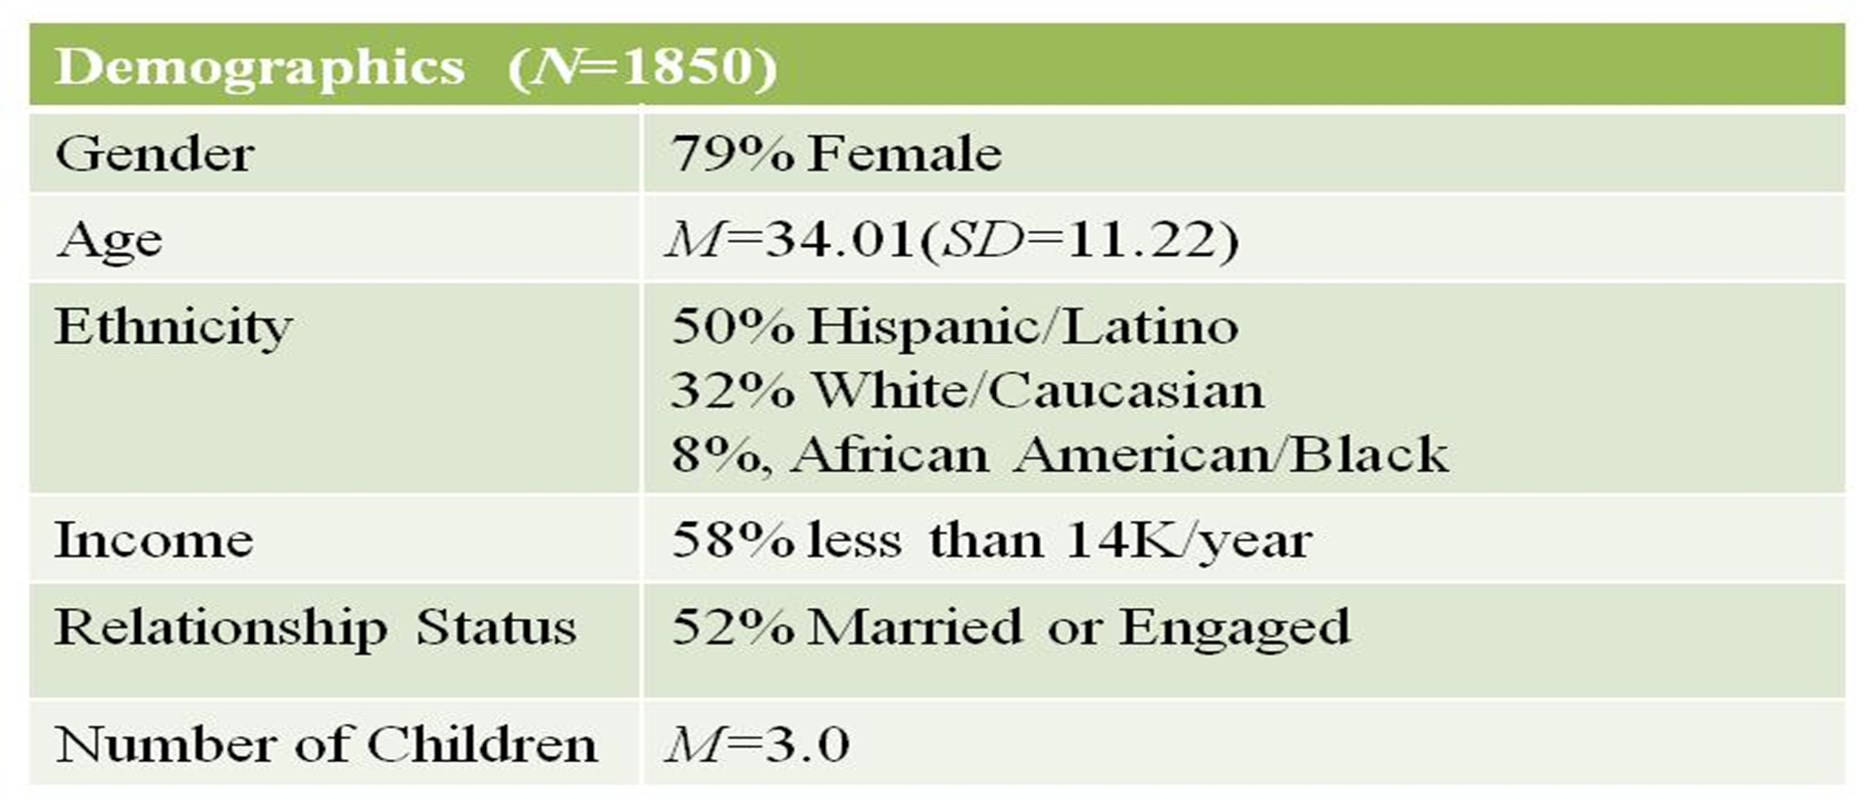
Holistic Relationship Programming with a Diverse Population
Sara Anne Tompkins, Juliana Rosa, Janet Benavente, Stephanie Mastroantonio, & Hannah Green
Colorado State University, Extension
Abstract
Results
The goal of the current study is to demonstrate the ability of Family Success in Adams County (FSAC) to provide a comprehensive approach to relationship enrichment to a variety of individuals including low income participants with different ethnic backgrounds. Current data supports our hopes by showing significant improvements over an extended period of time on measures of parenting alliance and perceived stress across income and ethnicity. It appears that FSAC is successful at helping diverse populations improve their relationships in a variety of domains.
Introduction
Marriage and healthy/stable relationships in general has lost
ground in the United States. Researchers across
disciplines have outlined how the decline in marriage and the
lack of healthy/stable relationships in America’s lower income
and minority populations has been linked to a variety of
negative and far reaching consequences. Specifically, this
decline has been linked to negative consequences such as
higher rates of divorce, single parenting, and non-marital
births (Dion et al., 2003).
In response to these concerns, the Healthy Marriage Initiative (HMI) was formed by the Administration for Children and Families (ACF; 2005). Family Success in Adams County (FSAC) is part of this initiative and takes a holistic approach to relationship enrichment by offering a variety of programming (relationship, parenting, & financial).
As there is a need to have comprehensive relationship programs focus on low income and ethnically diverse individuals, FSAC has a unique opportunity to aid in filling this research gap with our long term one-on-one follow-up model and our diverse population.
The purpose of this poster is to examine how our eclectic programming offerings effect broad outcomes that can influence all levels of relationships. Additionally, assessing if these programs are effective across income and ethnicity.
Participants approached significant improvement on parenting communication from pre to 18-months; F (1,12) = 2.71, p =.12.
No significant interaction was found (p > .05) ; Improvement was found for both income levels.
Repeated measures ANOVAs were run on parenting and relationship participants while examining the outcomes of PSS and PAM across time with income and ethnicity as between subjects factors*
Participants significantly improved in handling of stress from pre to 18-months; F (1,18) = 11.38,
p < .05.
No significant interaction was found (p > .05); Improvement was found for both ethnicities.
Discussion
Program Effectiveness
In the current preliminary examination, improvements in handling of stress and parenting alliance were found at 18-months post program across ethnicity and income. Improvement in parenting alliance is encouraging as this has been correlated to marital satisfaction and child adjustment (Abidin & Brunner, 1995). Improvements in perceived stress are also promising as this detects how unpredictable, uncontrollable, and overloaded respondents find their lives; these changes are indicative of long-term meaningful relationship improvements.
Further outcomes not shown here include improvement in Psychological Well-Being, Parenting Self-Efficacy, Family Functioning, and Relationship Confidence. Participants also rate quality of the programming and instructors as high, and 90% would recommend the class to a friend.
Ethnicity and Income
Noteworthy is that over half of our participants are minority and fall below poverty. Analysis included an examination of income and ethnicity on outcomes with no significance found (p > .05); indicating that programming is equally effective across income and ethnicity. One of the many strengths of our study is its ability to successfully reach out to and serve this at risk population.
Conclusion
As research has shown a need for helping diverse
individuals improve their relationship skills and
functioning (e.g., Knox & Fein, 2008), we are
heartened to show long lasting program effects with
these at risk groups.
We believe networking with local agencies
and the one-on-one approach taken by FSAC is
key to success with a diverse population.
Methods
Strong Empirical Approach:
Longitudinal follow-up (up to 24-months).
Use of valid & reliable scales (e.g., parenting alliance (PAM; Abindin & Brunner, 1995), perceived stress scale (PSS; Cohen, 1988)).
One-On-One contact with participants to build relationships.
Procedure:
Participants meet with Family Service Coordinator one-on-one, then complete at least 8 hours of the parenting (i.e., Make Parenting a Pleasure (MPAP; Birth to Three, Kumpfer, 1983), relationship (i.e., Within My Reach (WMR; PREP, 2008), and/or financial (Spend Some, Save Some, Share Some (SSS; CSU Extension) classes.
Complete an immediate post test and remain in contact with coordinator for six-month follow-up assessments up to 24-months.
Participants significantly improved in handling of stress from pre to 18-months; F (1,19) = 13.04,
p < .05.
No significant interaction was found (p > .05) ; Improvement was found for both income levels.
Participant Quotes
“I feel I have a deeper connection with my children and spouse.”
“I feel that the class has helped me learn how to communicate better as a mother and as a partner.”
“The class gave me motivation that I can do it and that there are resources and people who can help.”
“I learned to never give up as a parent because we have very important responsibilities.”
“I am more confident in the decisions and choices I have made with my children. I am enjoying being a parent.”
“I have learned to listen more to my partner.”
Participants significantly improved in parenting communication from pre to 18-months; F (1,14) = 3.35, p < .10.
No significant interaction was found (p > .05); Improvement was found for both ethnicities.
*small sample size used in current analyses due to time lagged data collection and missing data; final analyses will account for missing data using growth modeling
* Contact Sara Anne Tompkins (stompkin@colostate.edu)
*The purpose of this publication is the dissemination of technical information. Funding is provided through a grant from: U.S. Department of Health and Human Services-
Healthy Marriage Demonstration Grant #90FE0028. The opinion, findings, and conclusions or recommendations expressed in this event and associated materials are those
of the author(s), and do not necessarily reflect the views of the United States Department of Health and Human Services Administration for Children and Families.

